Slide 1
"Income Levels Across Different Age Groups"
Casey Patel

Slide 2

Problem Statement:
Can we predict future changes in age and income distributions based on historical data?

Slide 3
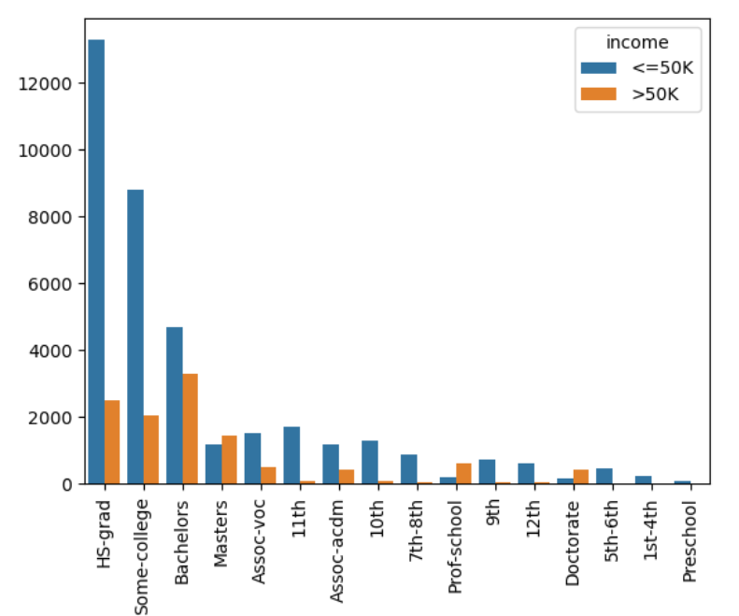
Key Findings
A positive correlation between income(<=50K):
Private Workclass
HS-Grad
Some college
Never Married
White
Male

Slide 4
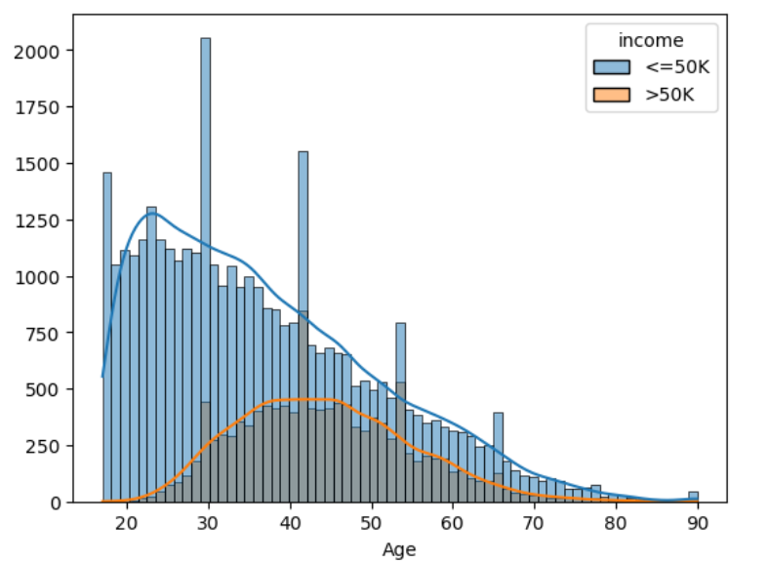
How Age and Income are related:
Most of the people having income less than or equal to 50K are between age 25-45
Most of the people having income more than 50K are between age 35-50

Slide 5
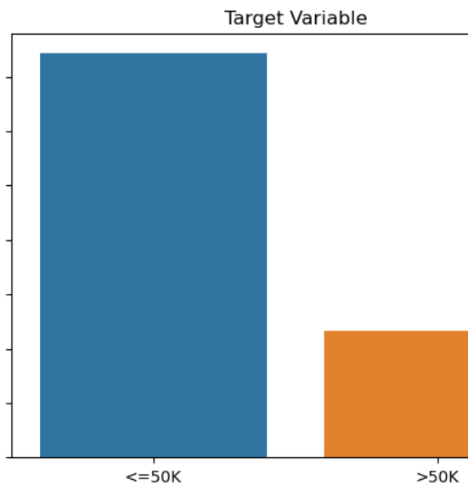
Income
More than half of the population is middle class earing less than <= 50K which indicates it would be essential to keep them in mind while introducing new product.

Slide 6

Conclusion:
We can predict that as age is changing the income is increasing as well
People with higher education tend to earn about 40% extra.
People who are not married tend to save more than those married.
Addition to that people who are working in government sector are earing more than working in private sector.

